Slide 1

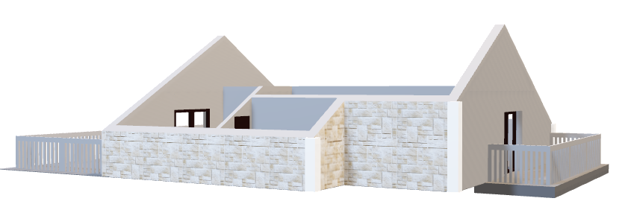
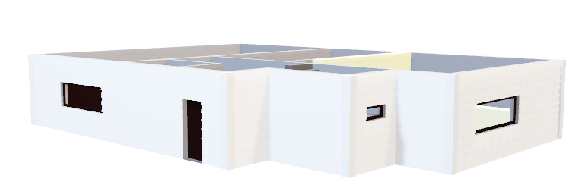
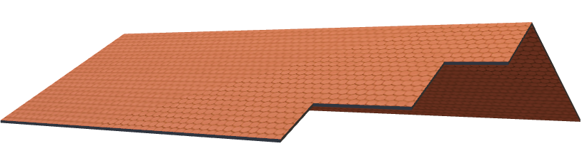
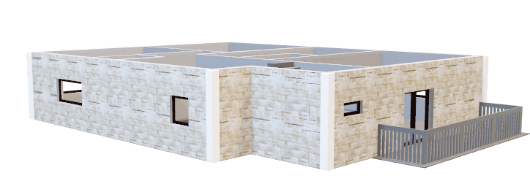
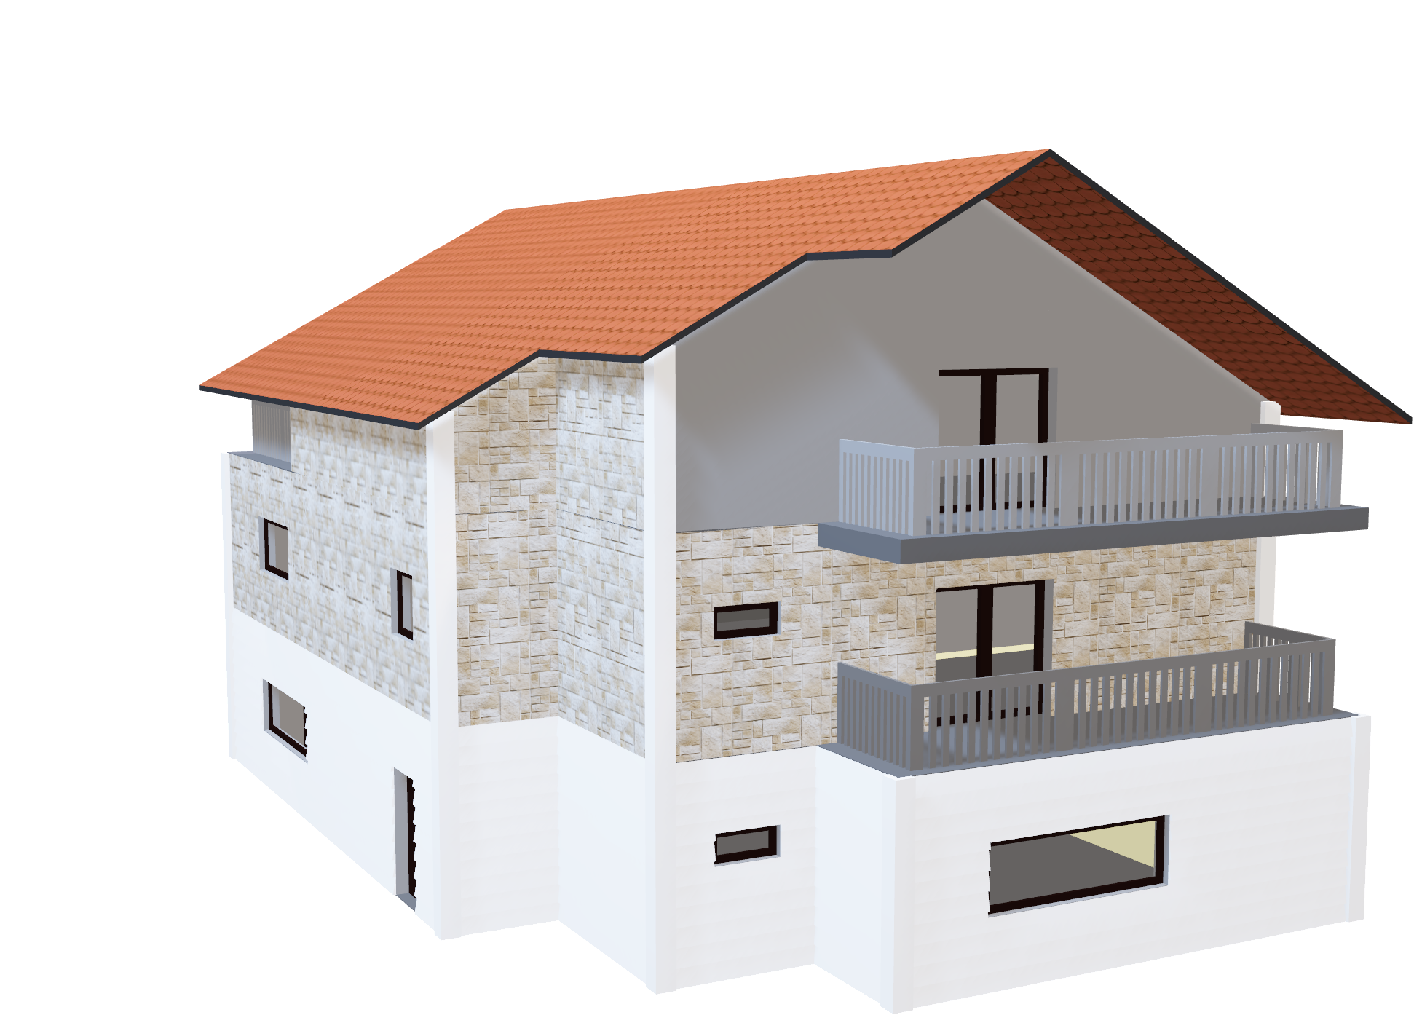
King County House Sales
Property value predictions
Notes:
In Project 2, we looked at the King County House Sales and present to King Count Real Estate who focus on providing homes to the King County Area.

Slide 2
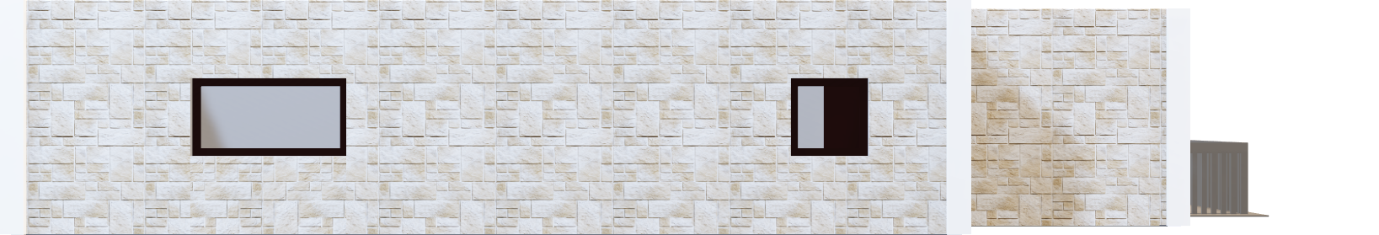
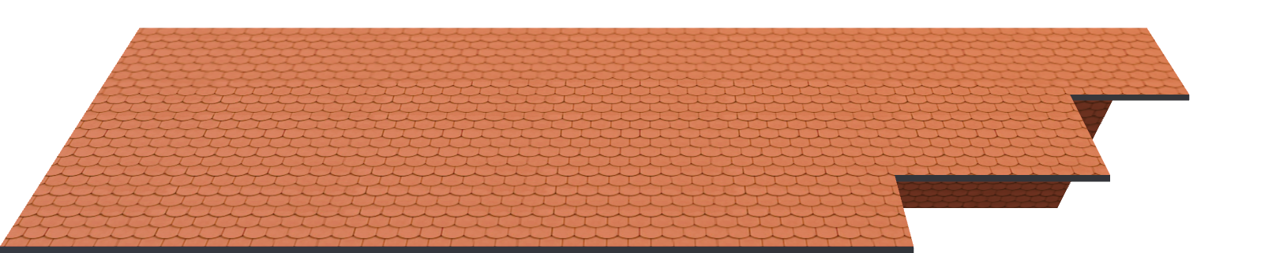


Summary
King County Real Estate agency want to provide valuable advice to their clients. We analyzed various property features to determine which could offer homeowners or potential buyers/investors greater return or value.
We found that larger living space, higher grade and waterfront homes increase the value of properties. We also found that selling between April and June result in higher prices, whilst February was the lowest and therefore a better time to buy.
Notes:
We asked the following questions: 1. Do houses with more interior living space and property space cost more?
2. Do higher grade homes cost more?
3. Do waterfront homes cost more? 4. What time of the year is best to sell or buy?
We found that larger living space, higher grade and waterfront view homes increase the value of the home. We also found that April and June resulted in highest prices, whilst February was the lowest.

Slide 3
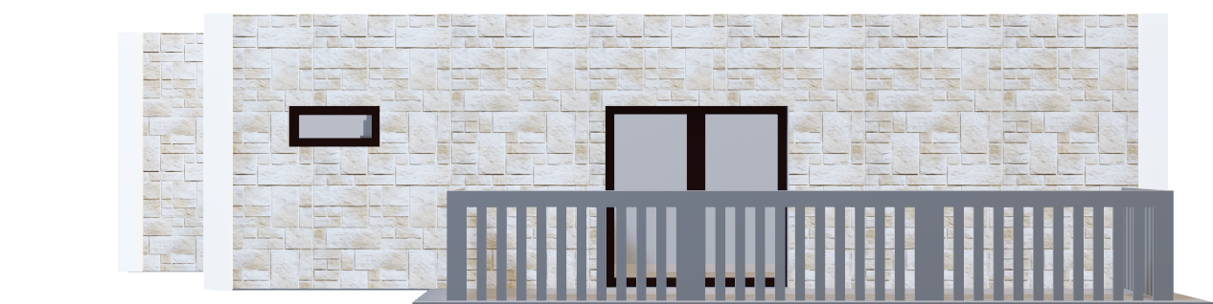


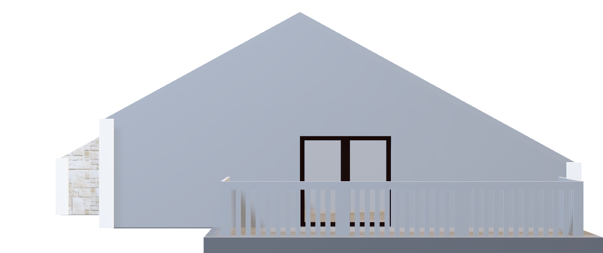
OUTLINE
Business Problem
Objective and approach
Data
Data adopted in analysis
Methods
Preparation, analysis and modeling data
Results and Conclusion
Interpretations and recommendations
Notes:
A quick outline cover our business problem, data analysis, modelling methods and finally our results and recommendations.

Slide 4
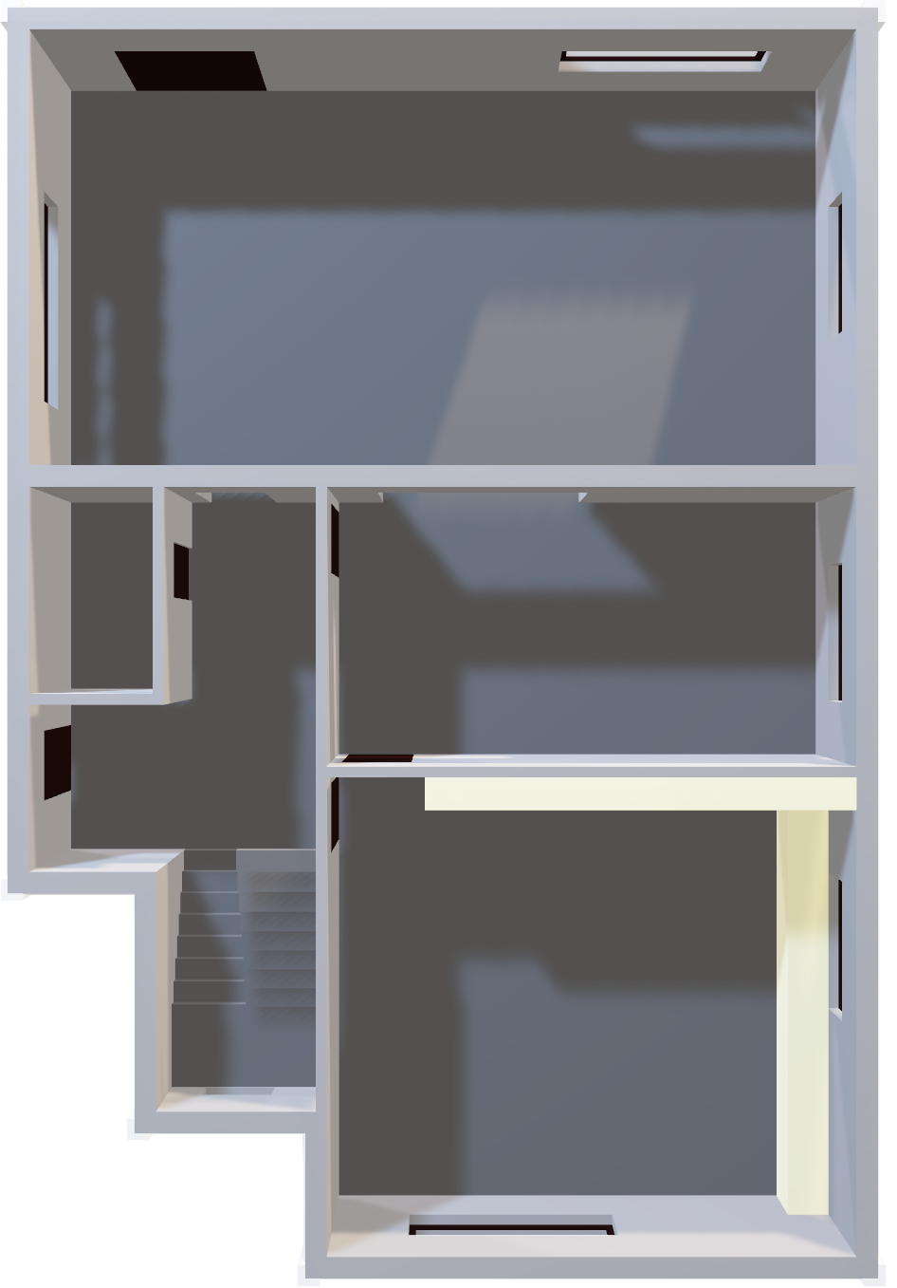

Business Problem
Better advising homeowners and buyers of King County properties.
Which features generate/offer most value to homeowners/buyers?
Features that affect property prices:
Living Space
Grade
Month sold
Waterfront views
Notes:
So we looked at the following selected features to assess which impact property prices the most.

Slide 5
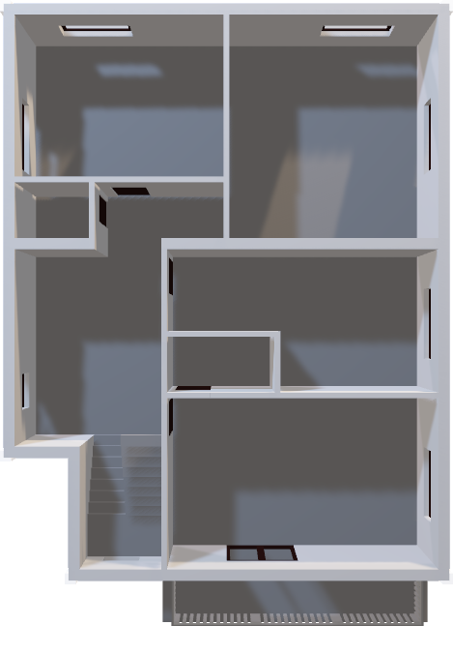
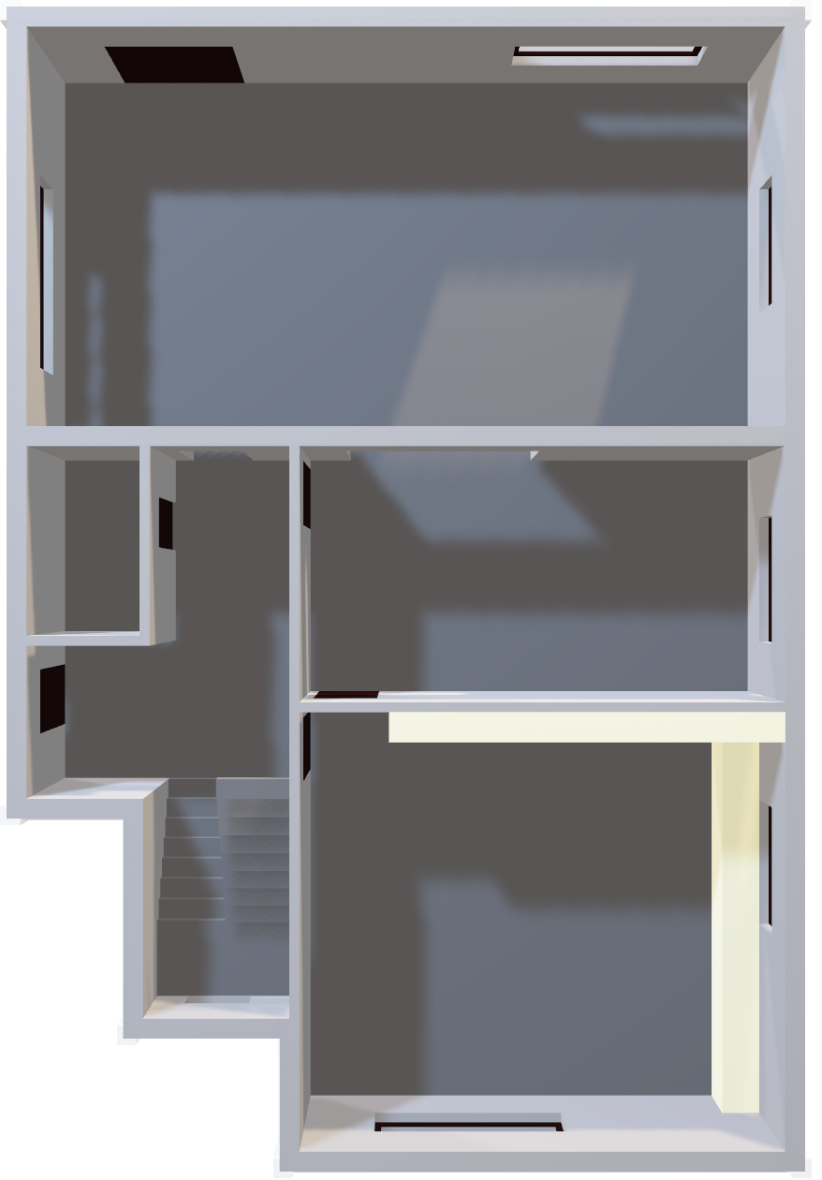

Data
Roof
3rd Floor
2nd Floor
Kc_house_data represents property features and prices data such as; no. of bedrooms, bathrooms, living space, condition, grade etc.
Notes:
Data features and price came in the one data set.

Slide 6
Method
Roof
Data imported and performed EDA with visualizations. Outliers removed, created ‘month_sold’ feature. Made assumptions on linear regression and assessed if any correlations between price and selected features.
Feature engineering to help final model predictions. Made hypotheses from selected features against target variable (price); month_sold, age of property and waterfront.
Model with Train-test split to assess fitment. Baseline to find worst fitment to compare to other models.
Determined R-Squared and feature coefficients, used Sklean. RMSE between two models. Final model in ‘housing_predictions.csv’
Notes:
Essentially we build a linear regression model to predict how much someone will pay for KC property.
Our models included different features to predict prices based on testing data.
We then compared the iterations of the models and determined which one predicted more accurately.

Slide 7
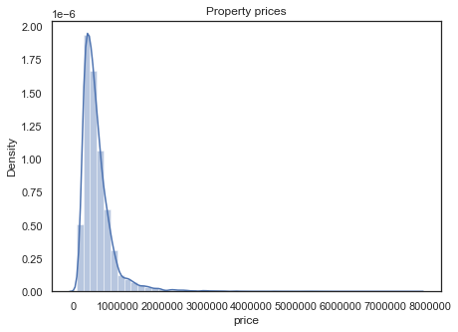


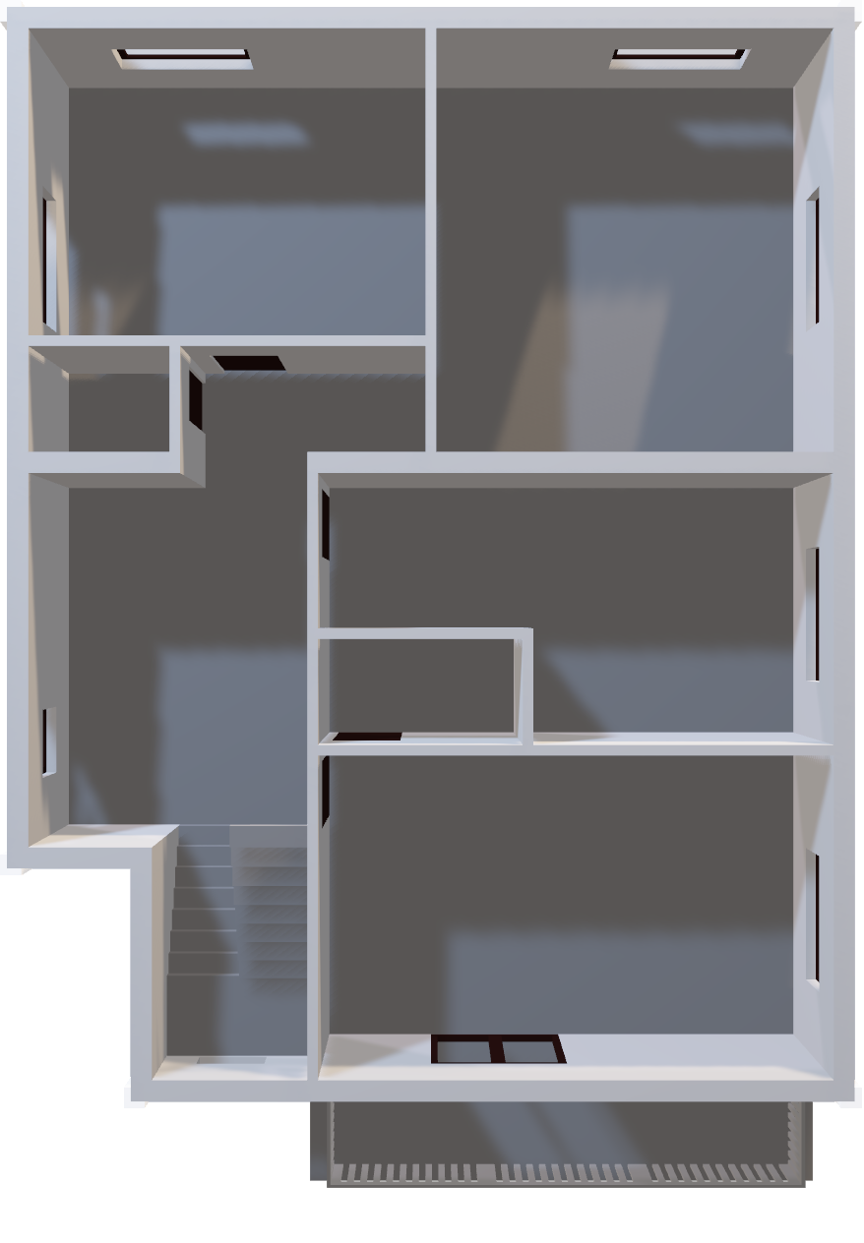
Results – Property Prices
Roof
Most houses were sub $1mil.
3rd Floor
1st Floor
Notes:
We found that most houses were worth <$1mil with little skew, which sounds reasonable.

Slide 8
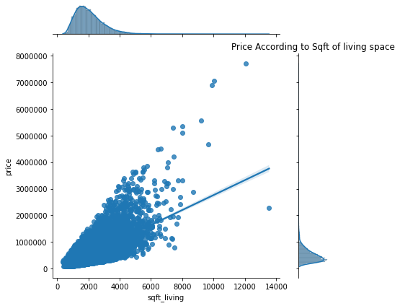
Results – Living Space
Roof
Greater living space generated higher property property prices.
3rd Floor
1st Floor
Notes:
We found high positive correlation between living space and $. The higher the living space the higher property value.

Slide 9
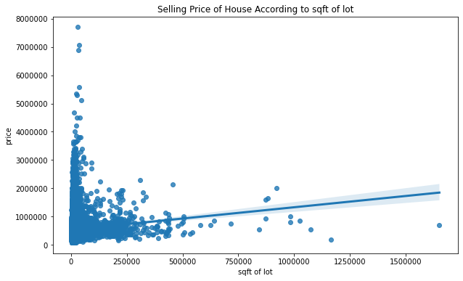
Results – Land Space
Roof
Land space had no visible correlations, surprisingly.
3rd Floor
1st Floor
Notes:
Surprisngly, not much relationship between the land space and price.

Slide 10
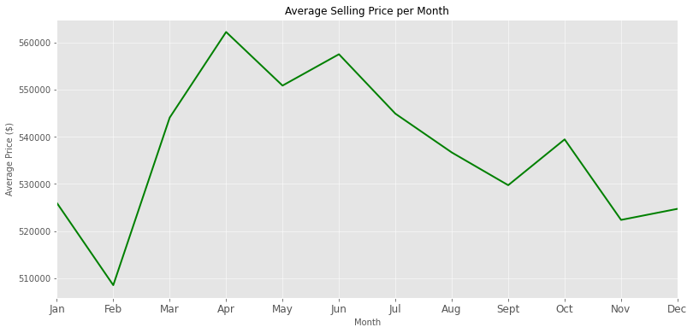
Results – Seasonality
Roof
February showing lowest house prices, whilst April-June shows highest prices and tends to dip off gradually and won’t pick up until March the following year.
3rd Floor
1st Floor
Notes:
We looked at average selling price per month which suggests that best time to sell is April to June. Best time to buy is probably Feb.

Slide 11
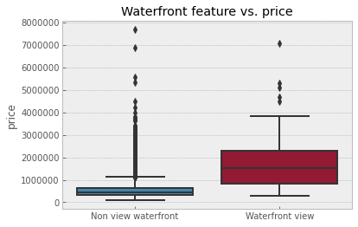
Results – Waterfront views
Roof
Waterfront view properties cost more than non-waterfront.
3rd Floor
1st Floor
Notes:
We also found that waterfront view homes cost significantly more than non waterfront homes.

Slide 12
Conclusions
Roof
If selling, sellers should look at ways to renovate and increase living spaces where possible. Buyers/investors should bear this in mind when buying.
Buyers should look at purchasing during lower performing months such as February, and sellers should put property on market during higher months April – June.
Waterfront properties tend to sell for higher, buyers can sell at a premium as it’s certainly a scarce value add. Whilst buyers/investors need to be prepared for the premium price.
Recommendation 1
Recommendation 2
Recommendation 3
Notes:
Therefore we make the following recommendations.
Increase living space size
Purchase during Feb and sell during April and June
Buy waterfront as they’re worth significantly more

Slide 13

Next Steps
Roof
There could be other variables that King County Real Estate and clients might be interested in, such as location. Perhaps there are certain catchment areas/locales that perform better than others depending on what’s around such as schools, hospitals, shops etc.
It is important to factor in economical shifts that could impact the results we’ve seen such as interest rate fluctuations or inflation.
2nd Floor
1st Floor
Notes:
Taking a deeper dive into suburb/location specific which offer better transportation, schools, shops etc may have impact on house prices. What do types of buyers/families want – looking at demographics of buyers.
Economical impacts, inflation or interest hikes could impact these results.

Slide 14
Thank You
Roof
annieliu1989@yahoo.com
https://github.com/annieliug/King-County-House-Sales.git

